Slide 1
BTA Online Apps
Mohd Fairus Ahmad

Slide 2
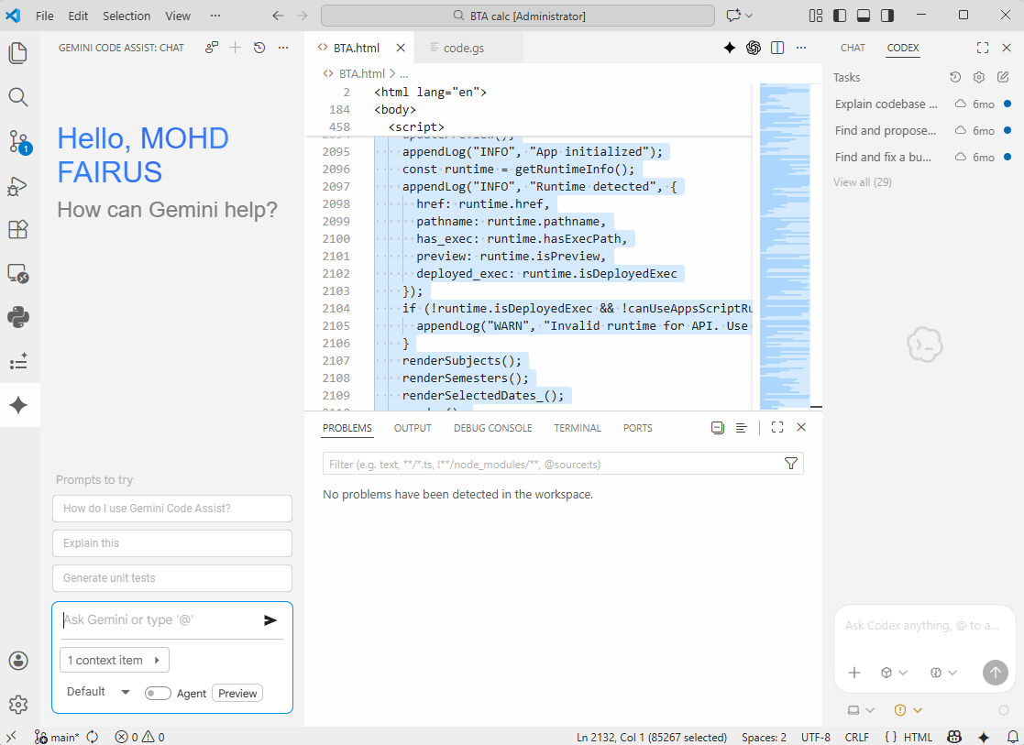
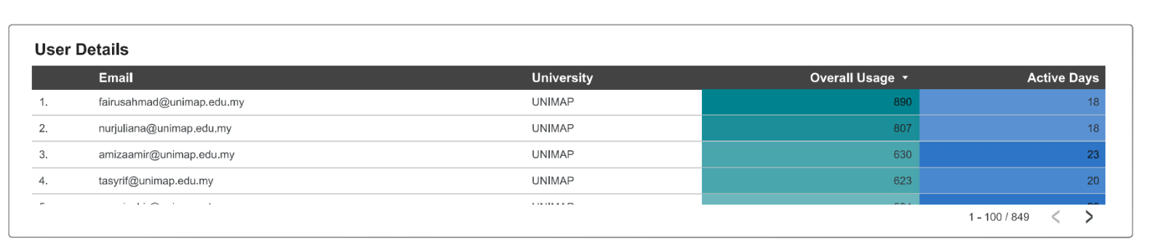
History: Nak mencuba Gemini pro

Slide 3
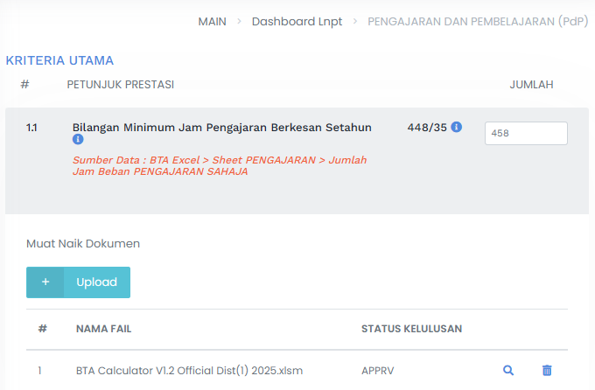
Minimum Jam Pengajaran Berkesan

Slide 4
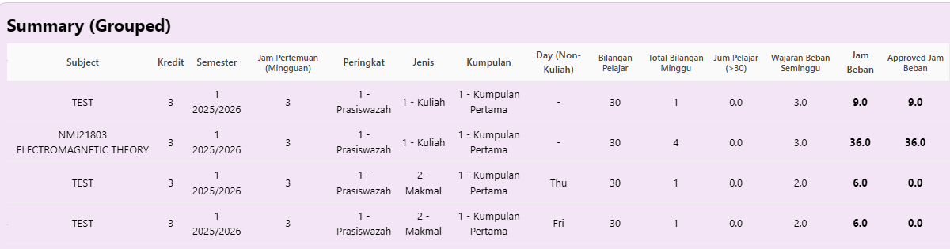
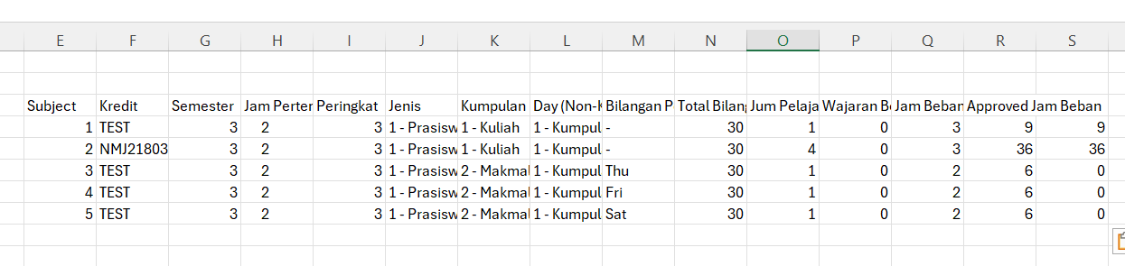

Slide 5
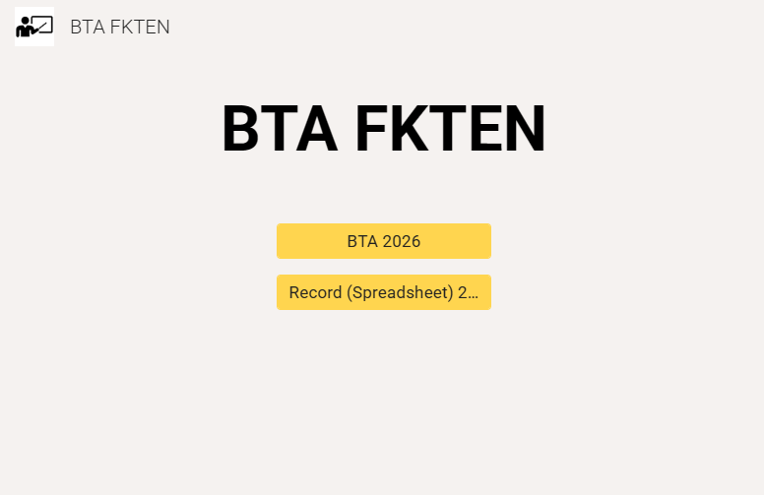
Front page
https://sites.google.com/unimap.edu.my/btafkten/home?
Berdasarkan tahun 2026
BTA Online Apps
Record for all staf using BTA Online Apps

Slide 6
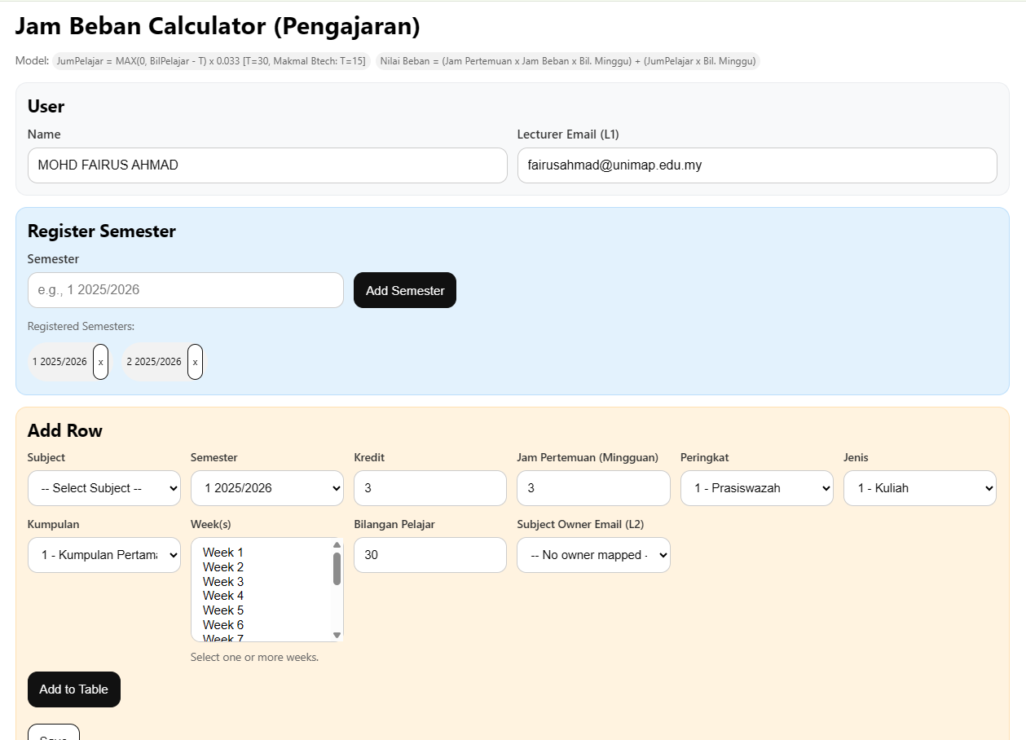
BTA Online Apps

Slide 7
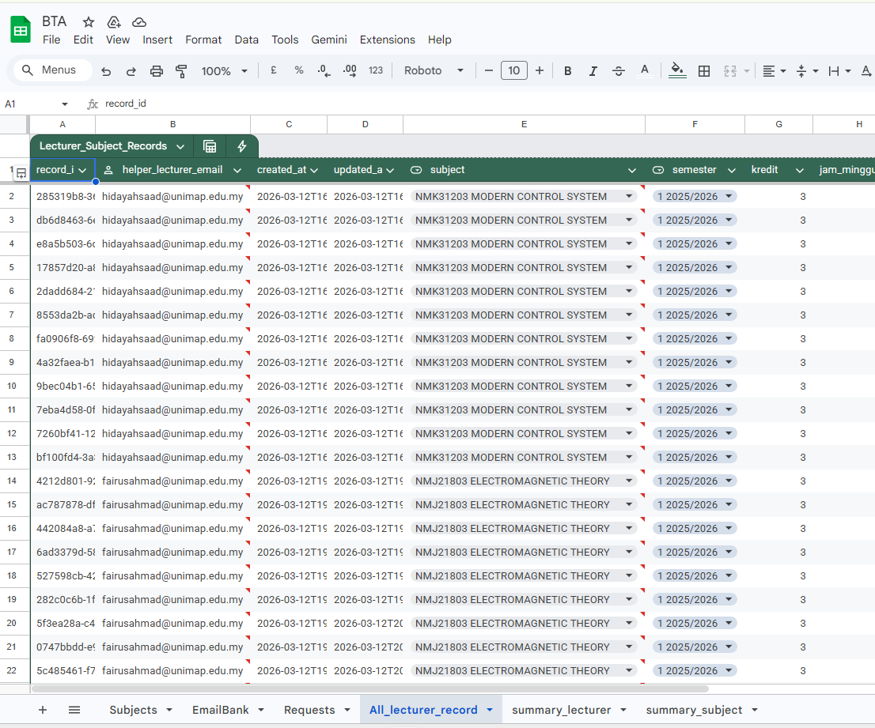
Record for all staf using BTA Online Apps

Slide 8
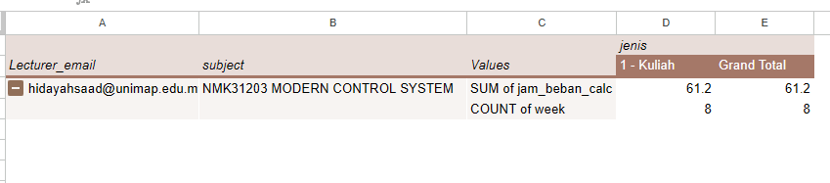
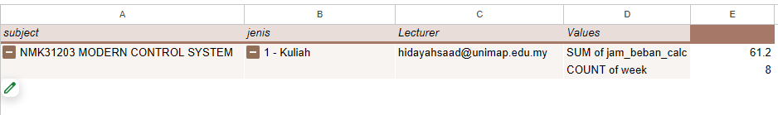
Check record
BTA record per lecturer
BTA record per subject

Slide 9
Penggunaan

Slide 10
Front page
https://sites.google.com/unimap.edu.my/btafkten/home?

Slide 11
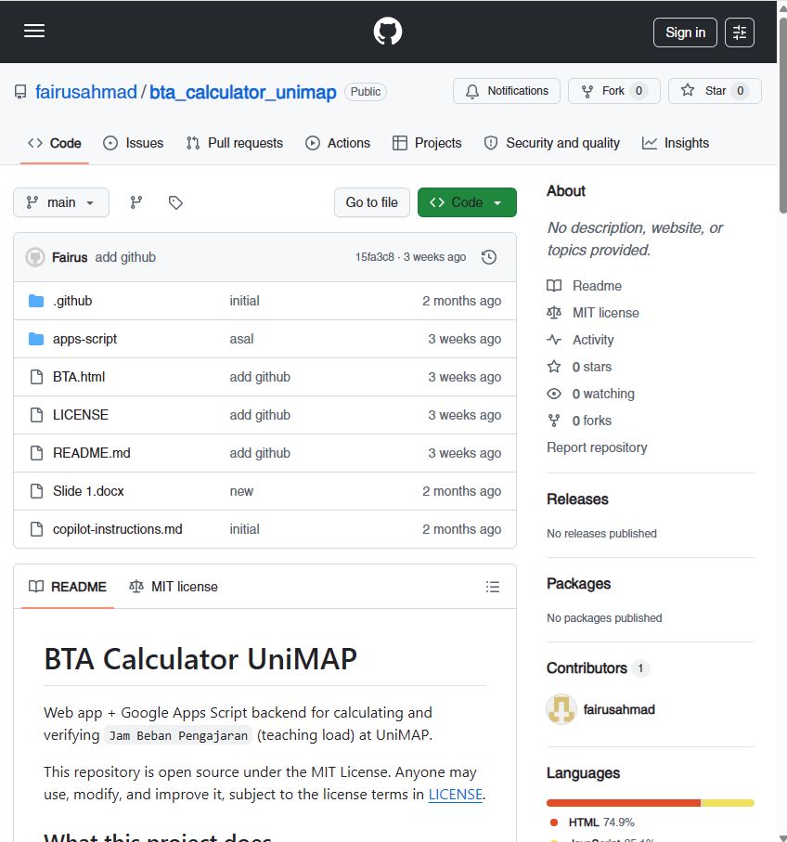
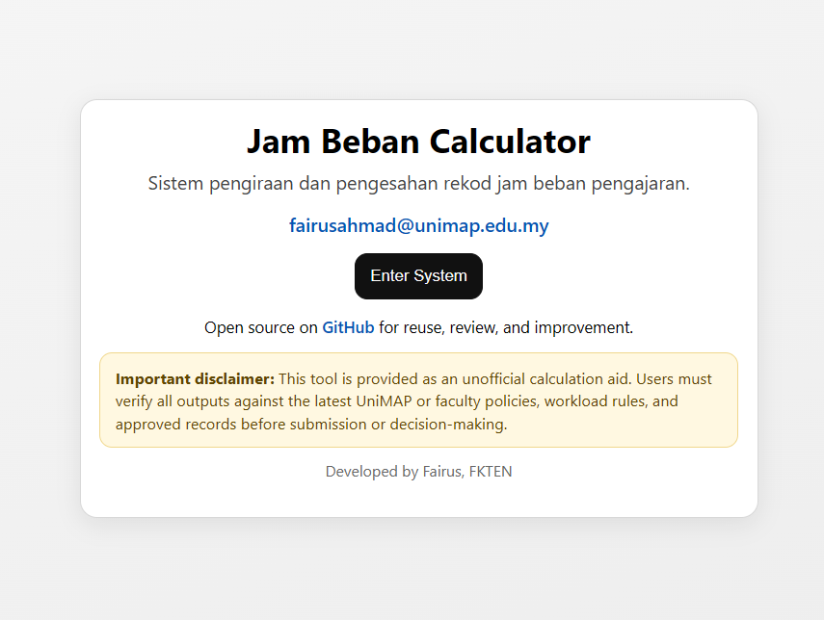
Username

Slide 12
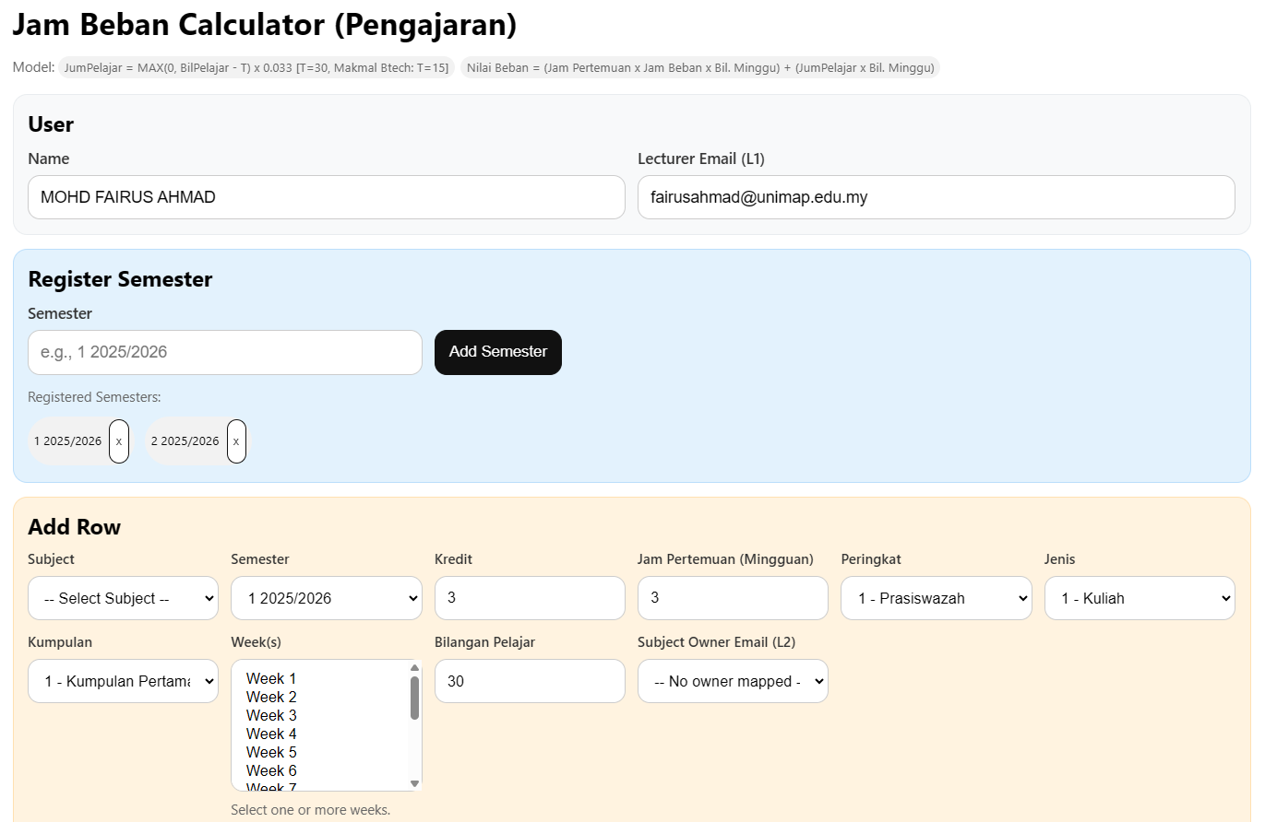

Slide 13
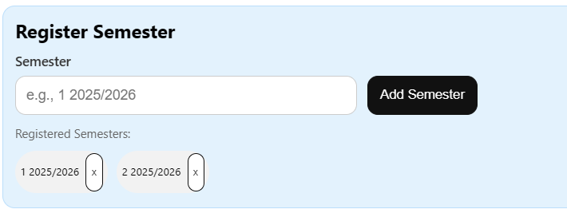
Semester registration
Register all semester in 2026
Deletable

Slide 14
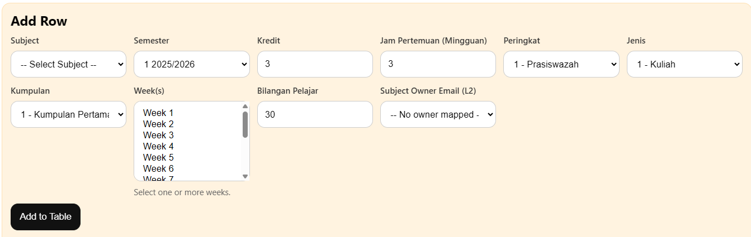
Choose subject and identifying subject owner
1. Choose subject
2. Choose owner Self (Automatic) Other (Select)
Multiple selection

Slide 15
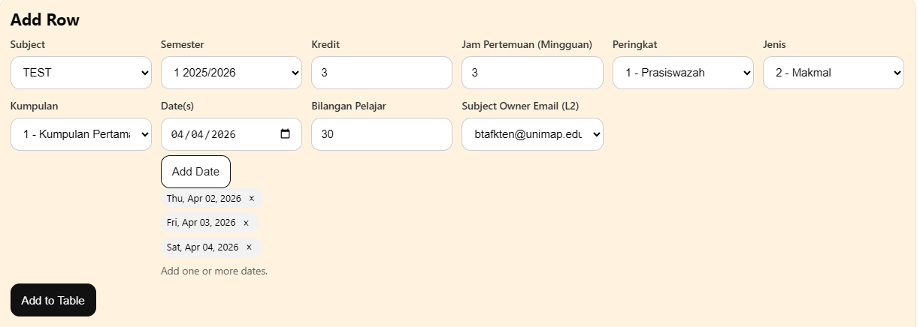
Jenis makmal

Slide 16
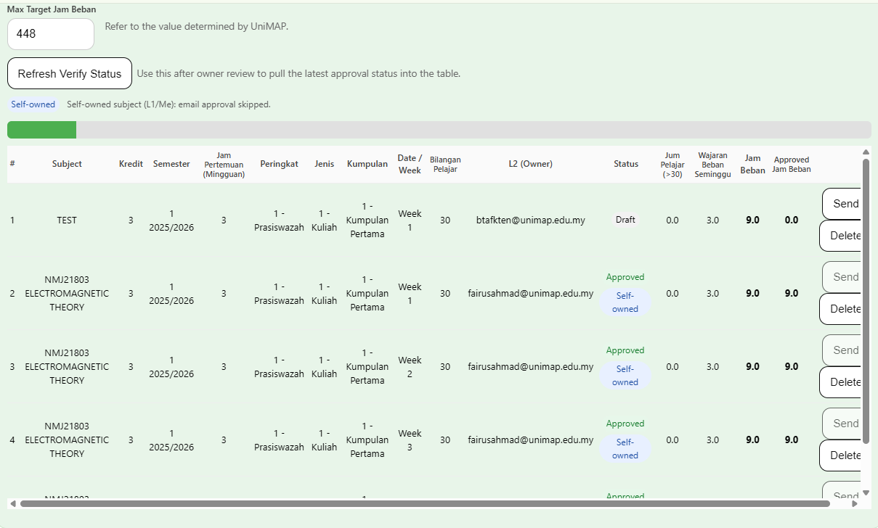
Self-owned subject vs other owner

Slide 17
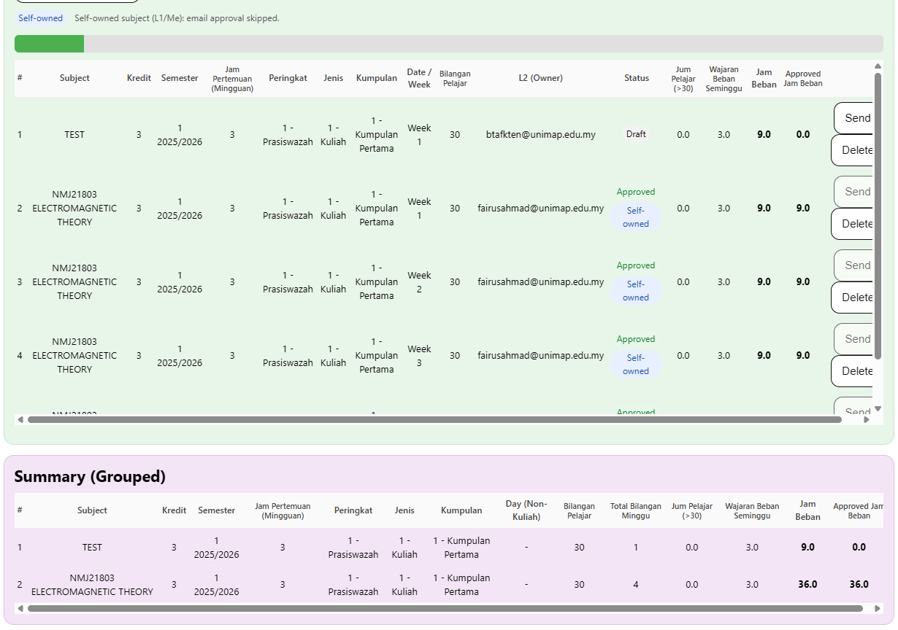

Slide 18
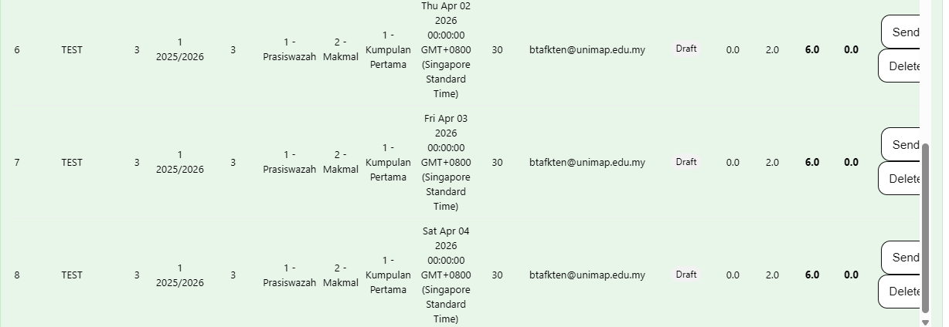
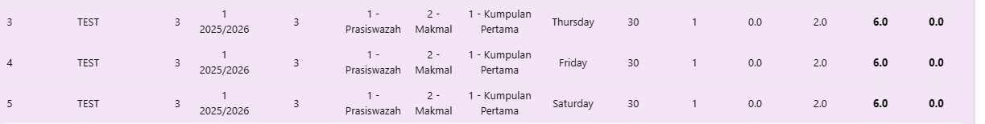
Jenis makmal (self/other owner)

Slide 19
Lab/class assistant & approval

Slide 20
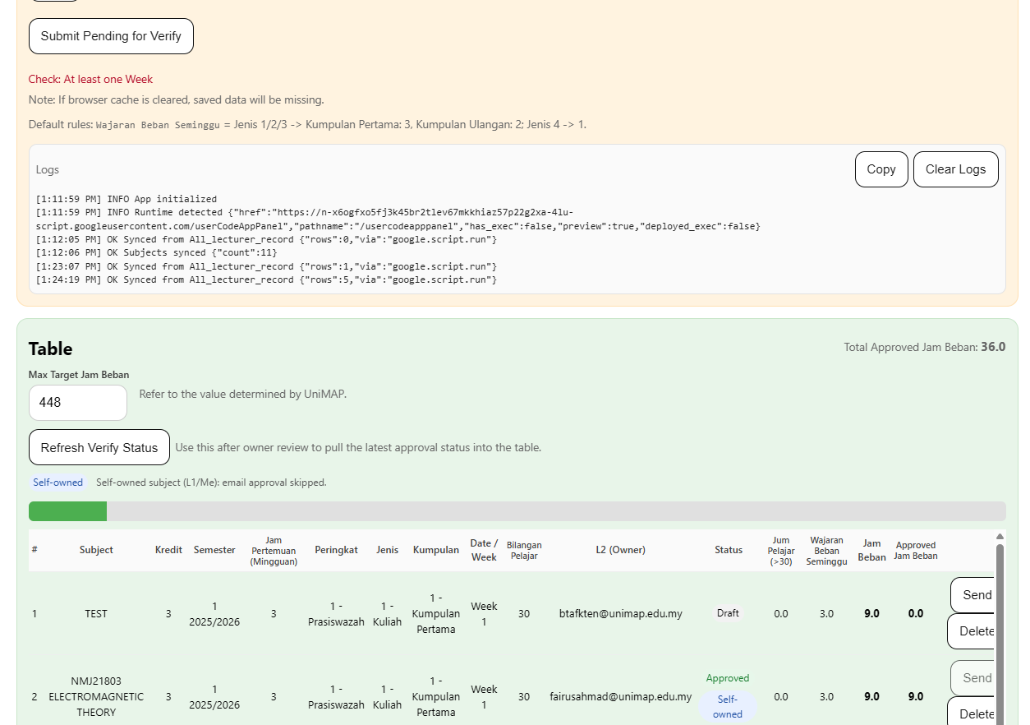
Request for approval
2
3
1

Slide 21
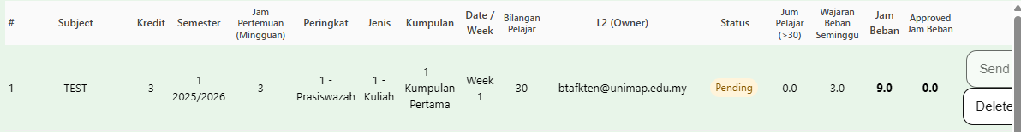
After click button “send”

Slide 22
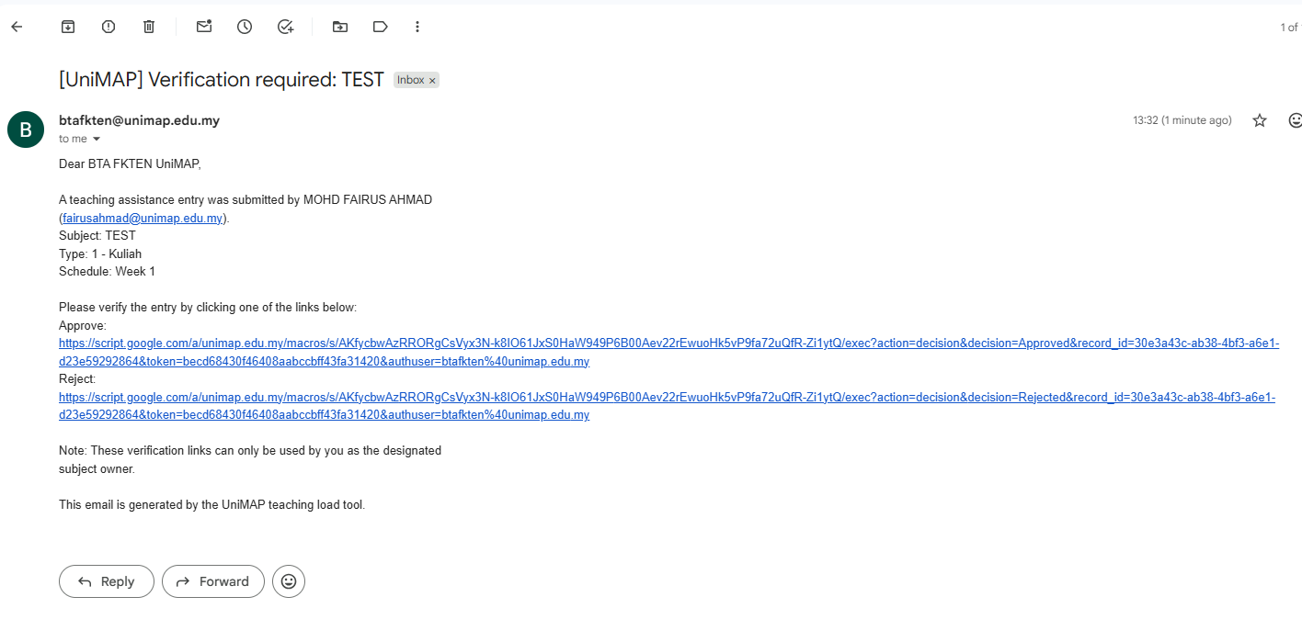
Subject owner receives email for approval

Slide 23
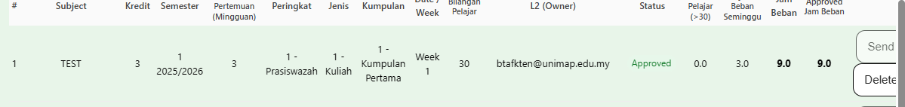
After click button “send”
If owner approved

Slide 24
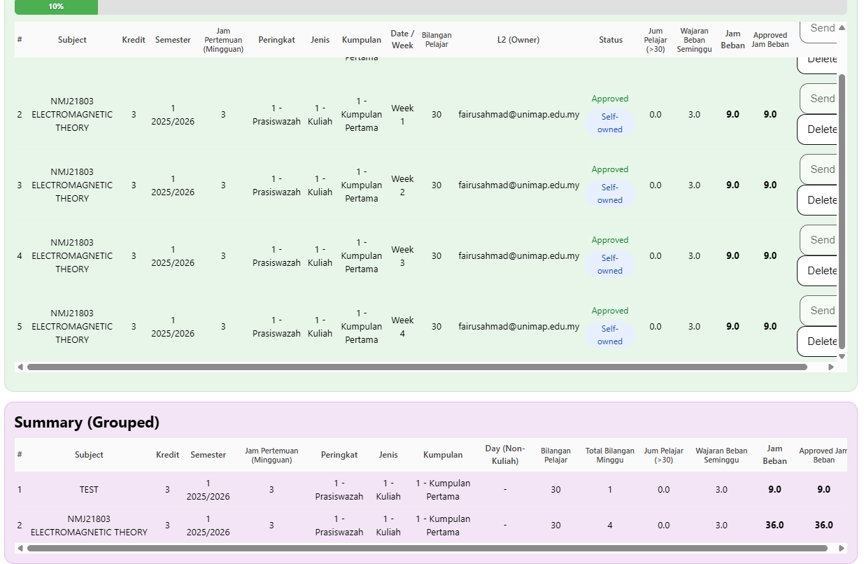

Slide 25
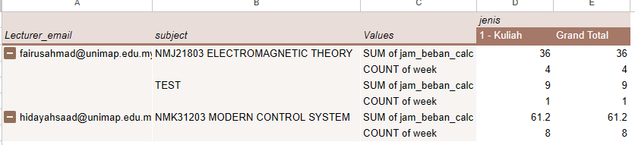
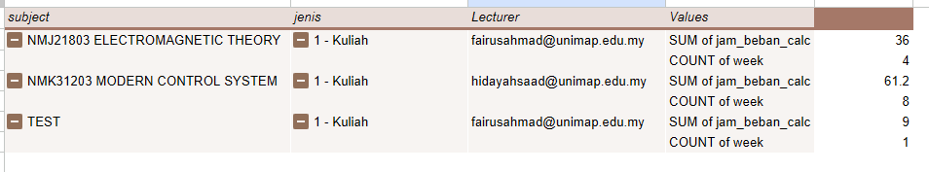
BTA record per lecturer
BTA record per subject

